Slide 1







CatSat: Integration and Testing for a University of Arizona CubeSat
Shae Henley, mentored by Dr. Dathon Golish
University of Arizona
2022 Arizona NASA Space Grant Statewide Symposium
April 23, 2022, The Hilton Tucson East

Slide 2
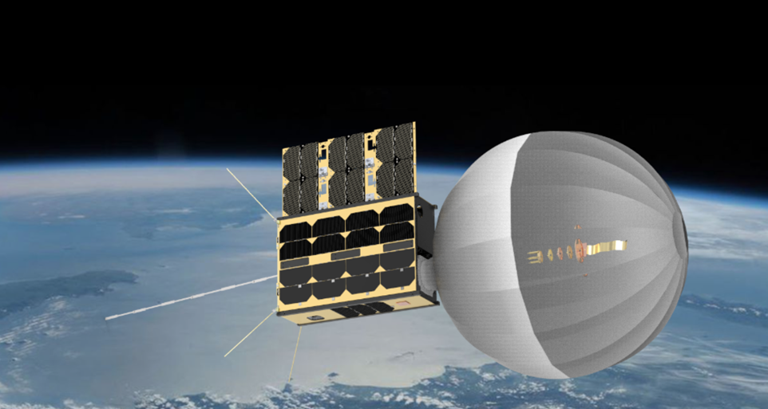
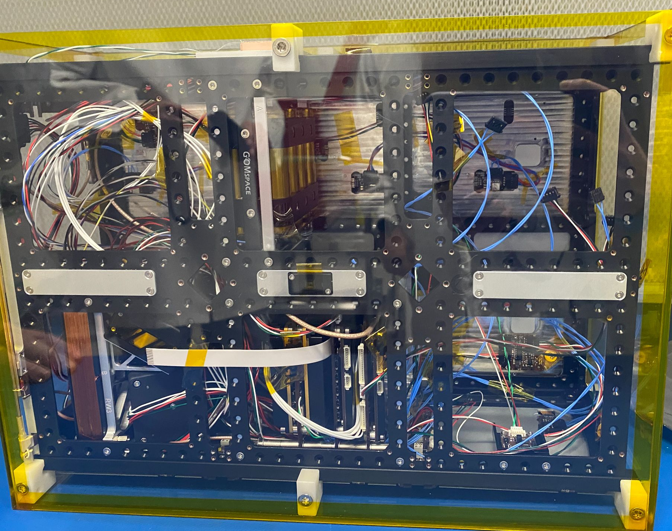
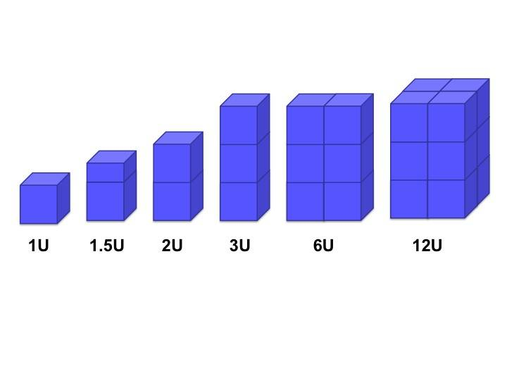
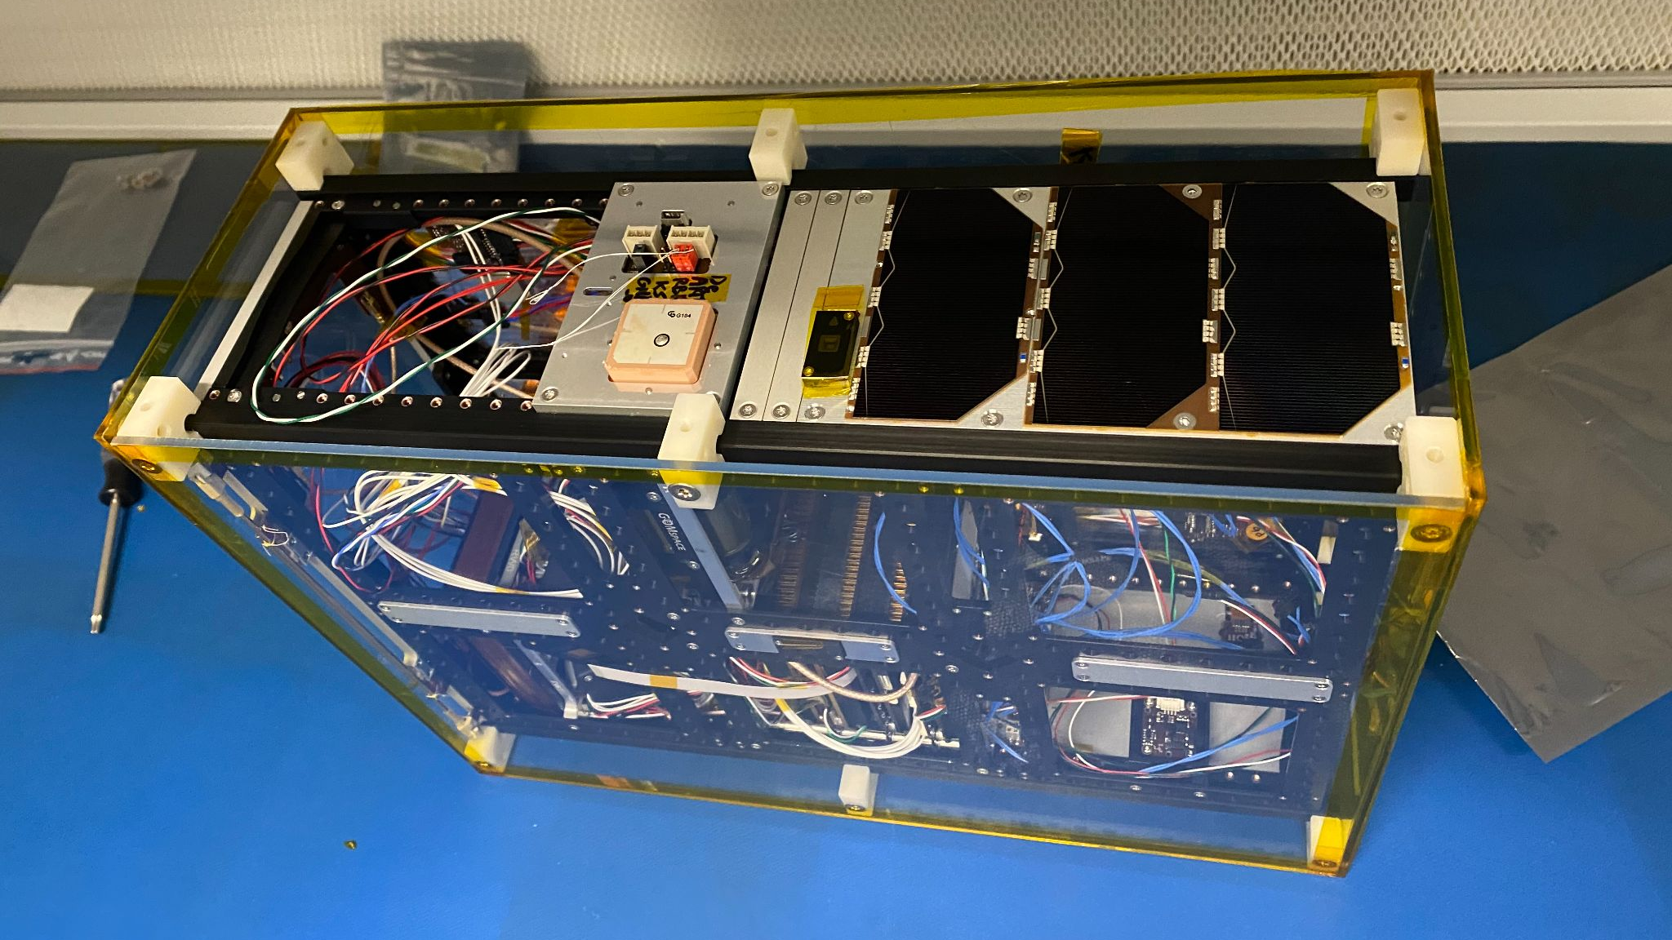
CubeSats: Small Satellites, Big Potential
- Range from 1U (10 cm³) to 6U in size
- Cost effective way to conduct research and scientific experiments in low-Earth orbit (LEO)
Common CubeSat Units
CatSat in low-Earth orbit depiction (Credit: CatSat website)
(Credit: NASA)
CatSat at Drake Building

Slide 3
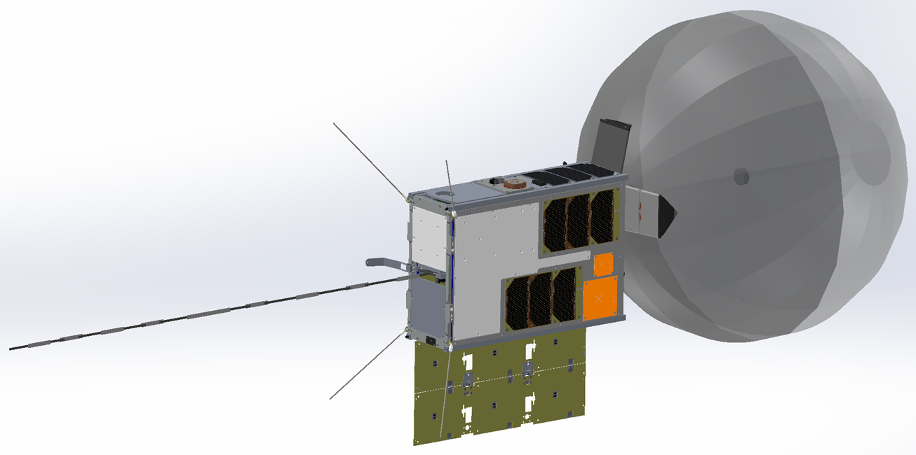
Antenna Technology, Ionospheric Research
CatSat aims to enhance satellite communications and study the Earth’s ionosphere.
Inflatable Antenna:
Satellite communications are limited to the size of their antennas; CatSat’s solution is the inflatable antenna
High bandwidth, low predeployment volume, low mass
WSPR Antenna:
Used to probe variation in the ionosphere
Orbit will start at the terminator (dawn/dusk); we want to measure diurnal (daylight) changes in the ionosphere
WSPR Antenna
Inflatable Antenna
CatSat 3D Model

Slide 4
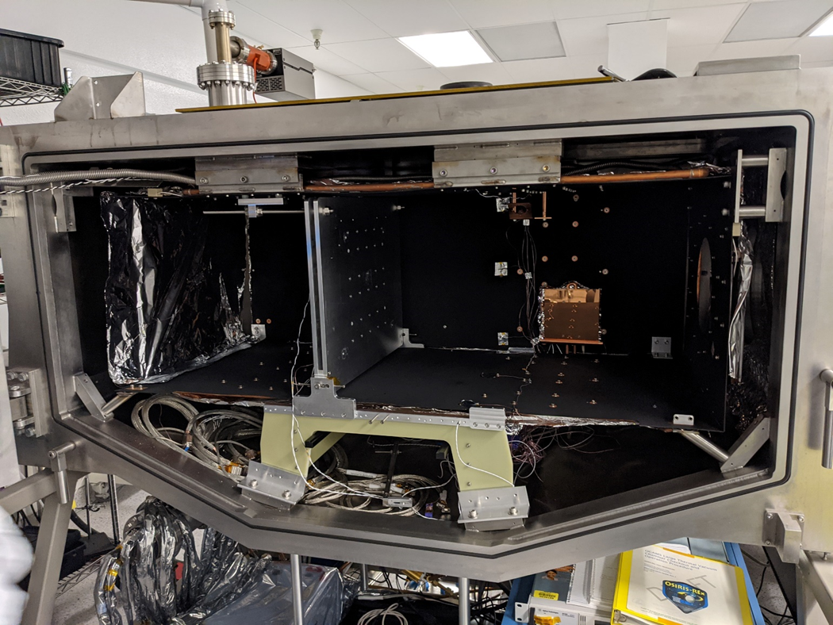
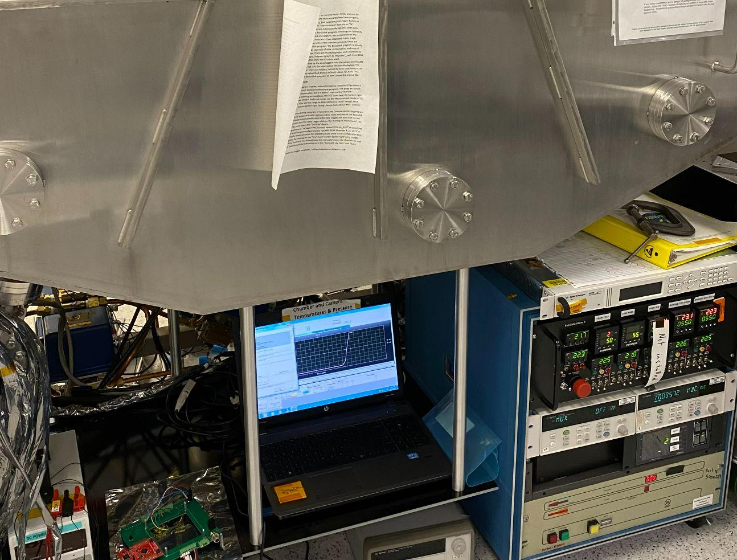
Functional and Environmental Testing
Functional Testing
Deployment Testing (IADS, WSPR):
• Burn wire activation
• Trapdoor release
• Antenna deployment
System Functionality:
• Communications
• Interface with other systems and instruments
Environmental Testing
• Basic fitment and functioning tests
• Thermal Vacuum Testing Thermal Cycle Test Thermal Vacuum Cycle Test
• Random Vibration Testing
The satellite must survive launch and function in LEO, where temperatures range from +3°C to +90°C at approximately 565 km.
Drake Building Testing Capabilities

Slide 5
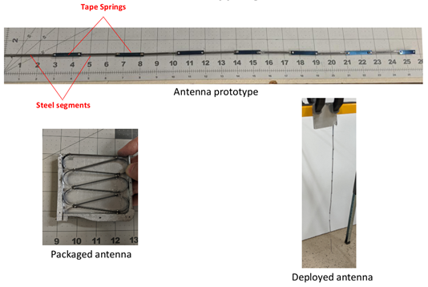
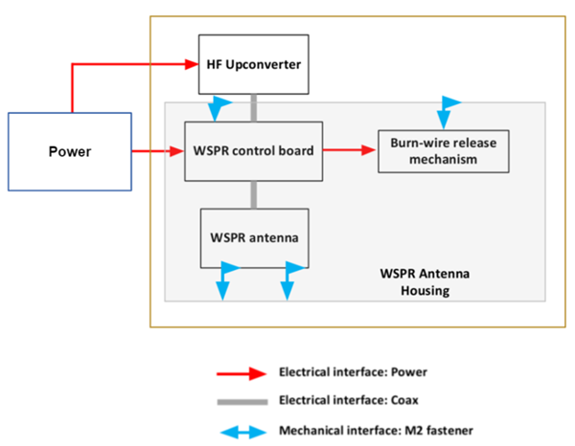
WSPR Antenna
The WSPR has two main functions: it receives messages from ground stations, and probes Earth’s ionosphere at specific frequencies to better understand diurnal cycles.
System functionality: antenna deployment and communication
WSPR Deployment
WSPR Antenna Interface Diagram

Slide 6
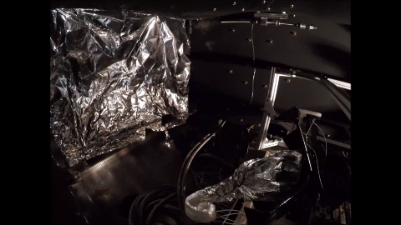
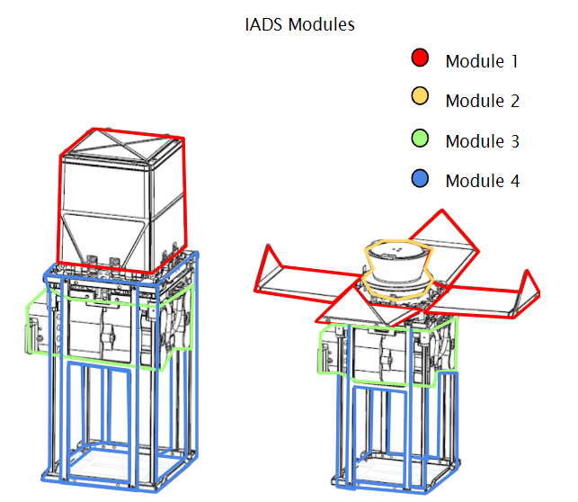
Inflatable Antenna: In the Cleanroom
Provides an opportunity for communication with high bandwidth, low mass, and low predeployment volume CatSat will be the first space flight demonstration of this technology Up to 50 Mbps data link from LEO with a 0.5 m antenna

Slide 7
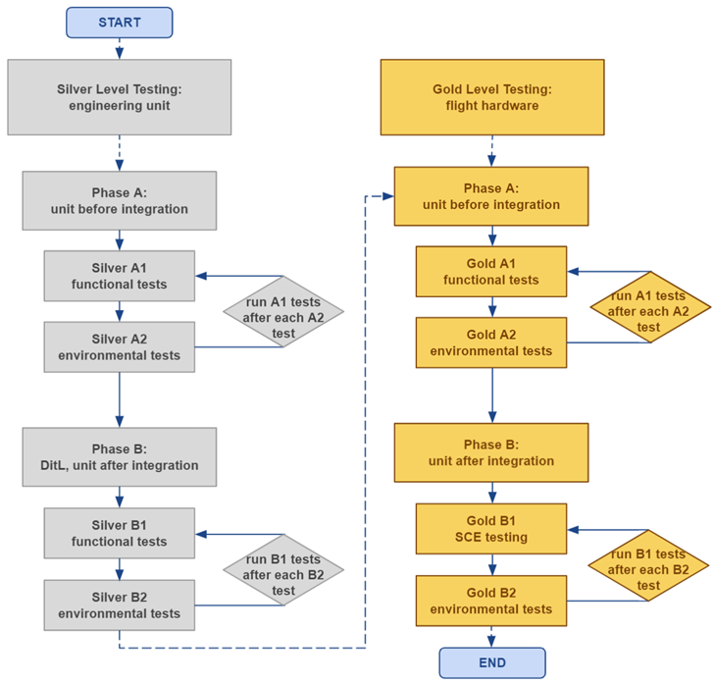
Results from Test Plans/Cleanroom
The technologies for the inflatable and WSPR antennas are working as planned; with each test, we determine more about the system and if any improvements or fixes are needed.
Development of a general test plan:
- Silver level testing with the engineering unit, and gold level testing with the flight hardware.
- We can run functional and environmental tests prior to integrating the antennas with the spacecraft bus, and after integrating the antenna (DitL testing and SCE testing).

Slide 8
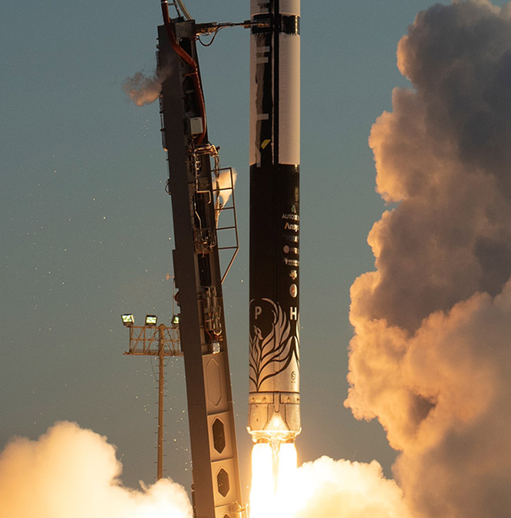
Significance & Future Impact
The development and successful completion of these tests in the lab ensures that these technologies will be ready to launch, function correctly, and last the lifespan of the CubeSat.
CatSat is planned to launch with Firefly Aerospace once completed; environmental tests will verify the satellite will survive launch conditions.
Data from the ionospheric testing will be made publicly available, and the deployment of the inflatable antenna in space will demonstrate the effectiveness of the new antenna technology, as well as show its potential for future missions.
Alpha Launch Vehicle, Firefly Aerospace

Slide 9
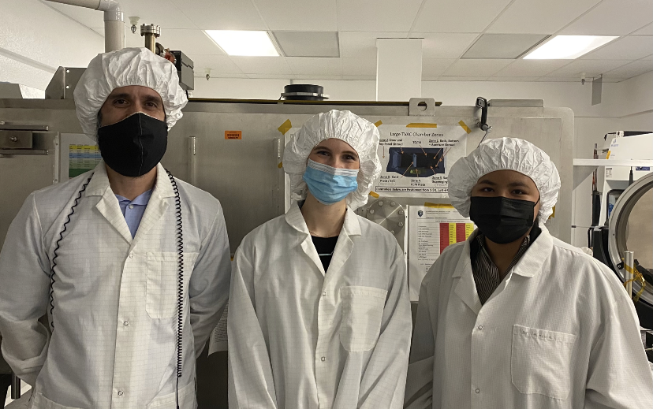
Acknowledgements
My mentor, Dr. Dathon Golish, and the amazing CatSat team!
University of Arizona, NASA Arizona Space Grant, FreeFall Aerospace, Rincon Research Corporation, Firefly Aerospace, NASA CubeSat Launch Initiative

Slide 10
Thank You!

